Slide 1
Algebra 4
Day 76

Slide 2
From Last Time…
Page 457 # 1–9, 13–27(odd)
Page 465 # 1–4, 30–33

Slide 3
7.5 Exponential and Log Equations
Objective:
Solve exponential and log equations

Slide 4
Strategies to Solve:
1.) One to One: rewrite so the bases are the same and compare
2.) Rewrite exponential in log form and apply the Inverse Property
3.) Rewrite log in exponential form and apply the Inverse Property

Slide 5

Examples: Solve
${1.) 3}^{x}=81$
2.) ln x–ln 2 = 0
${3.) 2}^{x}=8$
${4.) log}_{6}{2x=4}$

Slide 6
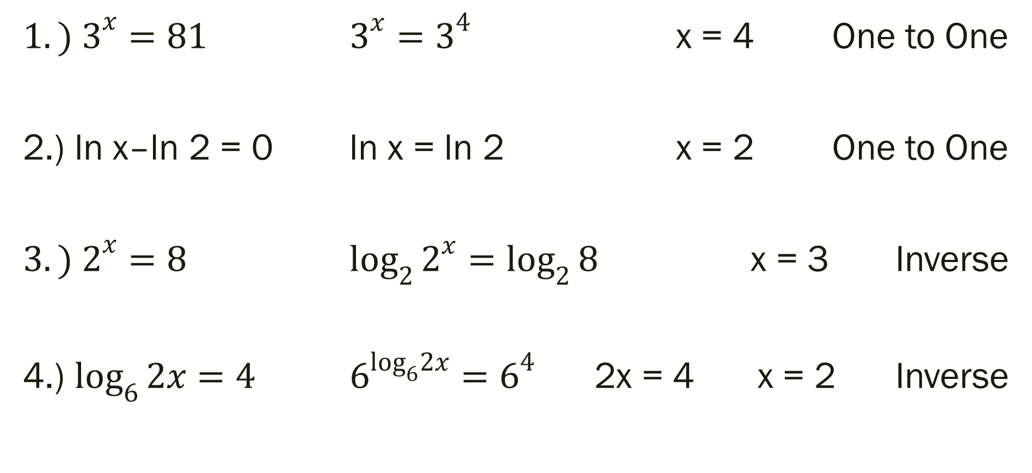
Examples
${1.) 3}^{x}=81$ $3^{x}=3^{4}$ x = 4 One to One
2.) ln x–ln 2 = 0 ln x = ln 2 x = 2 One to One
${3.) 2}^{x}=8$ $\log_{2}{2^{x}=\log_{2}{8}}$ x = 3 Inverse
4.) $\log_{6}{2x=4}$ $6^{\log_{6}2x}=6^{4}$ 2x = 4 x = 2 Inverse

Slide 7

Additional Examples
1.) ${8(2)}^{x}−10=70$ 5.) $3^{5x}=3^{3x−8}$
${2.) 5(3)}^{6x−12}+12=32$ ${6.) log}_{7}{(4x−7)=\log_{7}{(x+8)}}$
${3.) 4e}^{x+1}=12$ 7.) ln (6x – 1) = 3
${4.) 4log}_{2}\left(2x+9\right)−21=3$

Slide 8
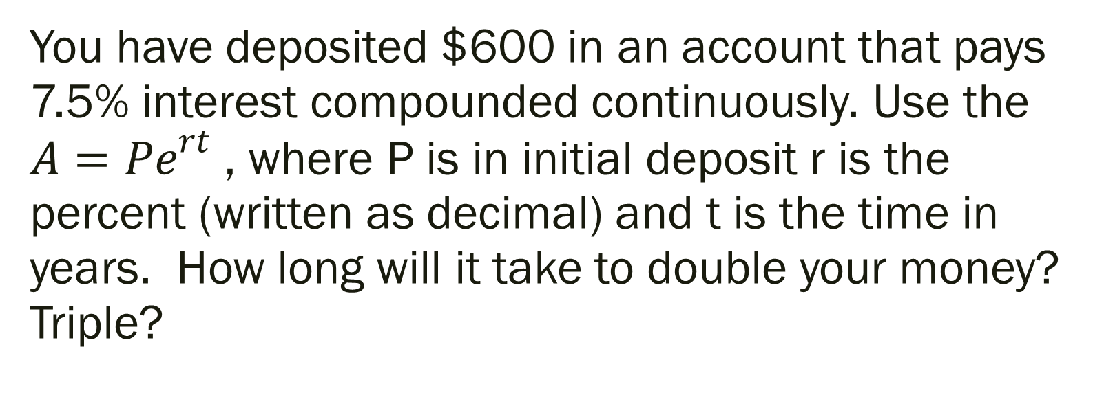
Answer the following.
You have deposited $600 in an account that pays 7.5% interest compounded continuously. Use the ${A=Pe}^{rt}$ , where P is in initial deposit r is the percent (written as decimal) and t is the time in years. How long will it take to double your money? Triple?

Slide 9

Set Up Solution
${A=Pe}^{rt}$ → ${1800=600e}^{0.075t}$ → ${3=e}^{0.075t}$ → t = ???
P = 600
r = 0.075
A = 1800 (tripled the P)
t = time

Slide 10
For Next Time
Page 473 #1–5, 7–23 (odd), 33–41 (odd)

